Slide 1
Home solar power and energy efficiency
(Or how I came to have a $14/month electricity bill)

Slide 2
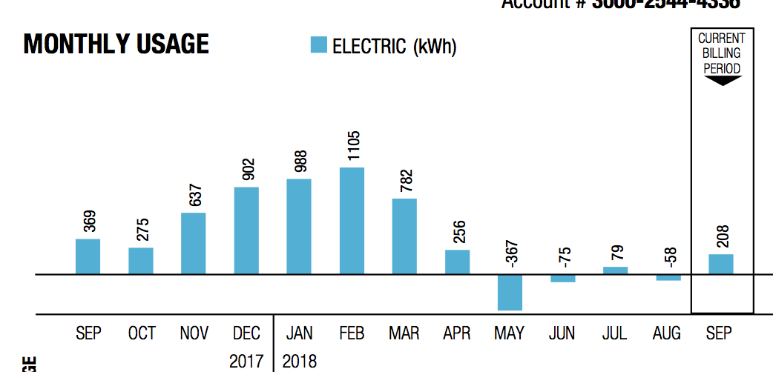
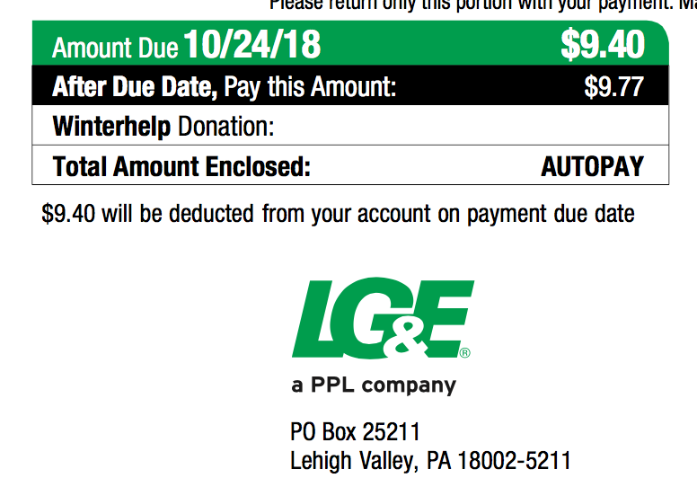

Slide 3
What’s it like to live with?
Why do it?
Before spending money on solar stuff…
Terminology
What does it cost?
Free money!
Payback/Return on investment
Retirement planning
Solar hot water
Off grid or grid tied
Inverter type
What would I need?
What’s involved in putting the system together?
Suppliers
Useful stuff/toys
State of solar power in Kentucky
Questions

Slide 4

What’s it like to live with?

Slide 5
No, you muppet, what’s it like to live with really?
With my system (7kw on the roof of my house, microinverters, net metering):
No maintenance (well, maybe hosing off the panels once in a while)
Electricity bill is a touch more complex to read but a LOT smaller
Er, that’s it. Plug stuff in, it works.

Slide 6
Why do it?
Low risk and high return investment: cash saved on electricity bill is after-tax lower bills are a big resale benefit
Good as part of retirement planning
Hedge against higher electricity prices in the future
Good for the planet (But so is roof insulation, walking places and going vegetarian)
It’s deeply cool making your own power
It is a fun DIY project
My friends and neighbors will be impressed/horrified

Slide 7
Before spending money on solar stuff…
Energy audit ($100) In my case, this led me to:
Roof insulation (12+ inches extra fiberglass insulation) ($1200)
LED lights ($200)
Seal round windows and doors ($30)
Seal the air leaks from outlet boxes (same caulk for windows)
Seal the AC ducting and insulate the duct in the roof ($100)
Energy star roof shingles

Slide 8
Terminology
Inverter – a chunk of electronics that turns the direct current (DC) power from the panel(s) into alternating current (AC)
Kw – kilo-watt, a measure of power. A hairdryer or a drip coffee maker use about 1 kw, the dryer uses about 3 kw. A 3’x5’ solar panel makes about ¼ kw in really bright sunlight.
Kwh – kilo watt hour, or a load of 1 kw for 1 hour. When you look at the electricity bill, this is what they are counting. Before I started my house used about 40 kwh per day (2400 sq ft ranch). LG&E currently charge around $0.12/kwh.

Slide 9
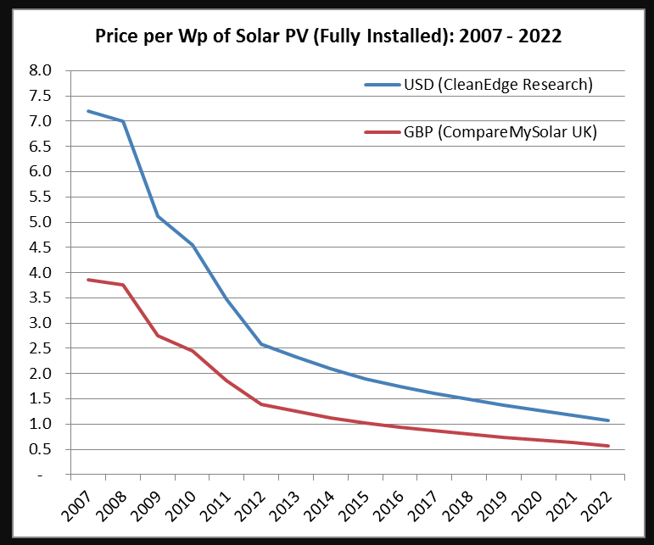
What does it cost?
Quote in 2013 for 3kw ground mount system was $18.5k.
Phase 1: 2013 DIY 5kw system (20 panels) - $11k (with $4.5k back) – the same system today would be $8k (with $2.4k back)
Phase 2: 2016 DIY 2kw from Craigslist - $2k
Neighbor bought 3kw DIY system from Craigslist for $3.4k
You can start with a single panel system for about $200…
Until the end of 2020 you get 26% back as a tax credit ☺
Solar hot water systems can be had for about $2k
Rough guide – DIY grid-tie is $1/w, professional grid-tie install is $3/w to $4/w and off grid with batteries is going to be around $6/w to $7/w.

Slide 10
Free Money!
First, the Federal government will give you a 26% tax credit on all money you spend on solar (water heating and photovoltaic equipment).
That 26% also includes tools, wiring, electrical and plumbing changes and so on. It does NOT cover your labor if you install it yourself, nor does it cover replacing your roof.
Second if you run a business from your house and you live in a rural area (Oldham county for example counts) you can apply to “Rural Energy for America Program” for grants and loans of up to $20k .

Slide 11
Payback/return on investment
There is a LOT of rubbish talked about how long solar takes to pay for itself, and it is rubbish because it implicitly assumes the installed solar panels have zero value once you install them.
The correct way to price them is as an investment, where the install cost is the capital, and the saved money from bills is the (after tax) interest on that capital.
In Kentucky the new net metering rules come into play on January 1st 2020, and any net meter system installed before then is grandfathered in on the old rules – and importantly this deal can be passed on to anyone that buys the property. This has significant value.

Slide 12
Retirement Planning
Any steps you take to reduce your future bills are useful as part of retirement planning.
Buying roof insulation, better windows, sealing behind outlets and solar energy can be thought of as techniques to buy yourself lower bills (and more disposable income) in the future.
With the Federal tax credit of 26% this year, the government is helping out here more than in any other retirement investment.
Energy improvements are unlinked to market prices, and indeed tend to be more valuable in times with high energy price volatility.

Slide 13
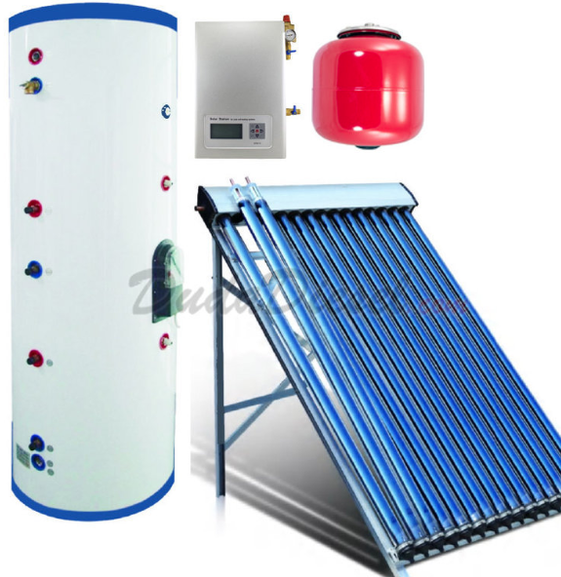
Solar hot water
Preheats water before it runs into your hot water tank
Solar collector on the roof, with a circulator pump and additional hot water tank
Water heating is 10%+ of house energy use
Best done as addition to current hot water system (preheat tank)
Some lifestyle changes …you want to run the washer, dishwasher etc. at night

Slide 14
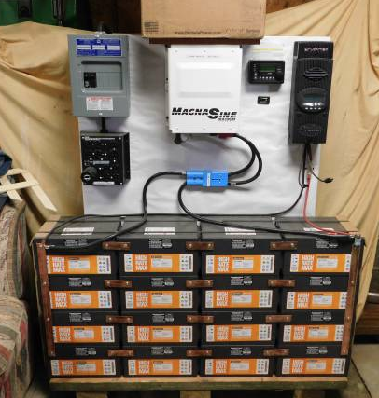
Off grid
Off grid – no electricity bill ☺
You provide all your own power – and don’t depend on the grid.
Significantly more expensive because it uses (lots of) batteries
Regular maintenance for batteries
Bad weather for prolonged periods means using backup generator
Great if the utility wants more than $50k to connect you to the grid
Almost impossible to find a professional installer that will do this for you.
*This is badly wired – don’t do this!

Slide 15
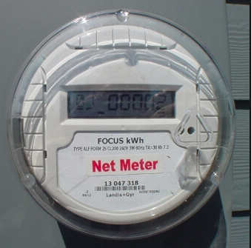
Grid tied
Grid tied – your house is still connected to the grid
You still get a bill ☹
If there’s snow on the panels for a week you still have power
You don’t have to replace all your power consumption with solar
Very low maintenance
This is what I have...

Slide 16
What would I need for grid tied PV?
You don’t need to replace all the power you use from the grid – start small, but get the meter changed THIS YEAR!
Sun! So you need a clear view of the southern sky
Roof or space in the yard
Size of system is measured in kW – one panel is about 3’x5’ and makes about ¼ kW.
System comprises panels, inverters, wiring and a mounting system
If you needed 25kwh/day, we get about 5 hours of sunshine per day so you would need 25 / 5 or 5kw of solar panels, about 20 panels.

Slide 17
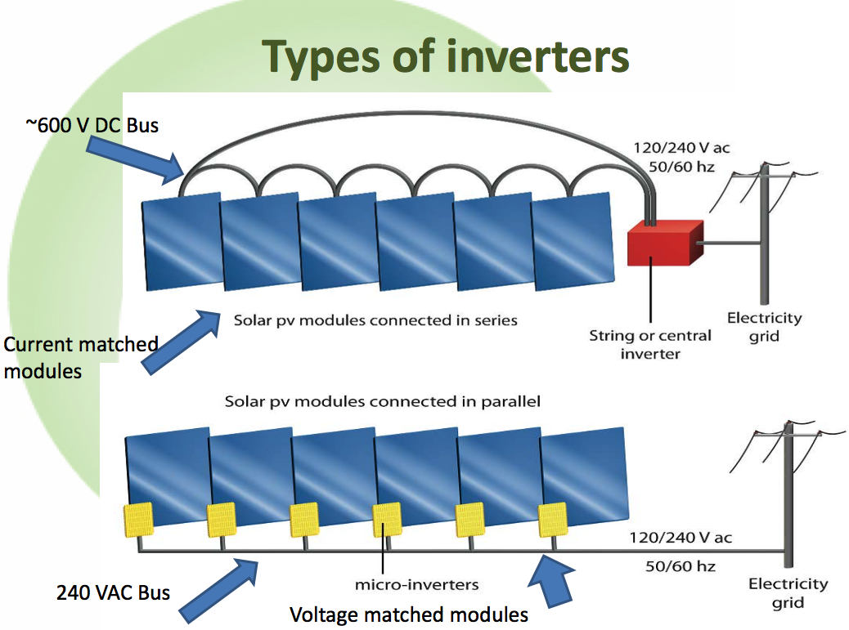
Wattage matched modules plugged into power optimizers which are connected in series

Slide 18
Inverter types
“Single string” photovoltaic solar power One or two large inverters fed by multiple panels wired together Exciting DC voltages (600v+) and issues with shading
Possibly more reliable due to inverter being inside the house and running at a lower temperature
“Micro-inverter” photovoltaic solar power One inverter every one or two panels Regular house voltages (240v AC)
More fault tolerant – one inverter failing doesn’t stop power production
“Hybrid inverter” – grid tied inverter which can also provide power if the grid goes down. There are examples that are micro inverters (IQ-8) and string inverters like Solar Edge.

Slide 19
What’s involved in putting it together?
Plan system
Apply for net meter (See links)
Get electrical permit (As a home owner, you can do electrical work except anything requiring a utility disconnection/ reconnection)
Get building permit (Beware, if you have trusses you will need a structural analysis)
Order parts
Install system
Get electrical inspection
Get net meter
Go live!

Slide 20
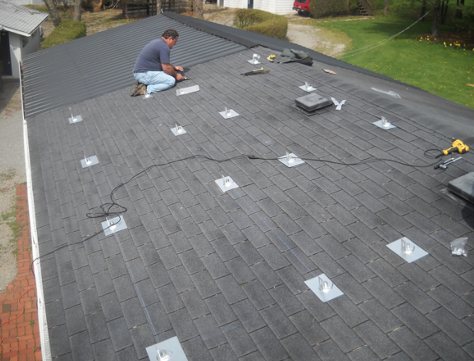
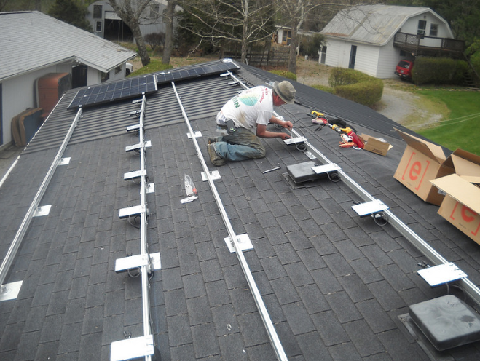

Slide 21
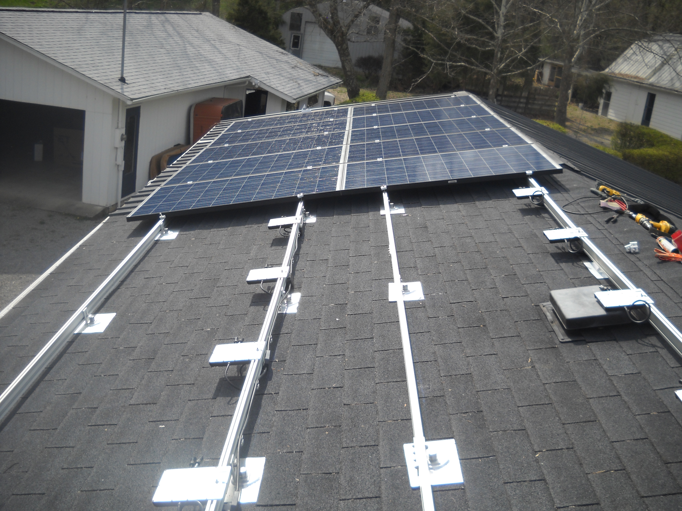
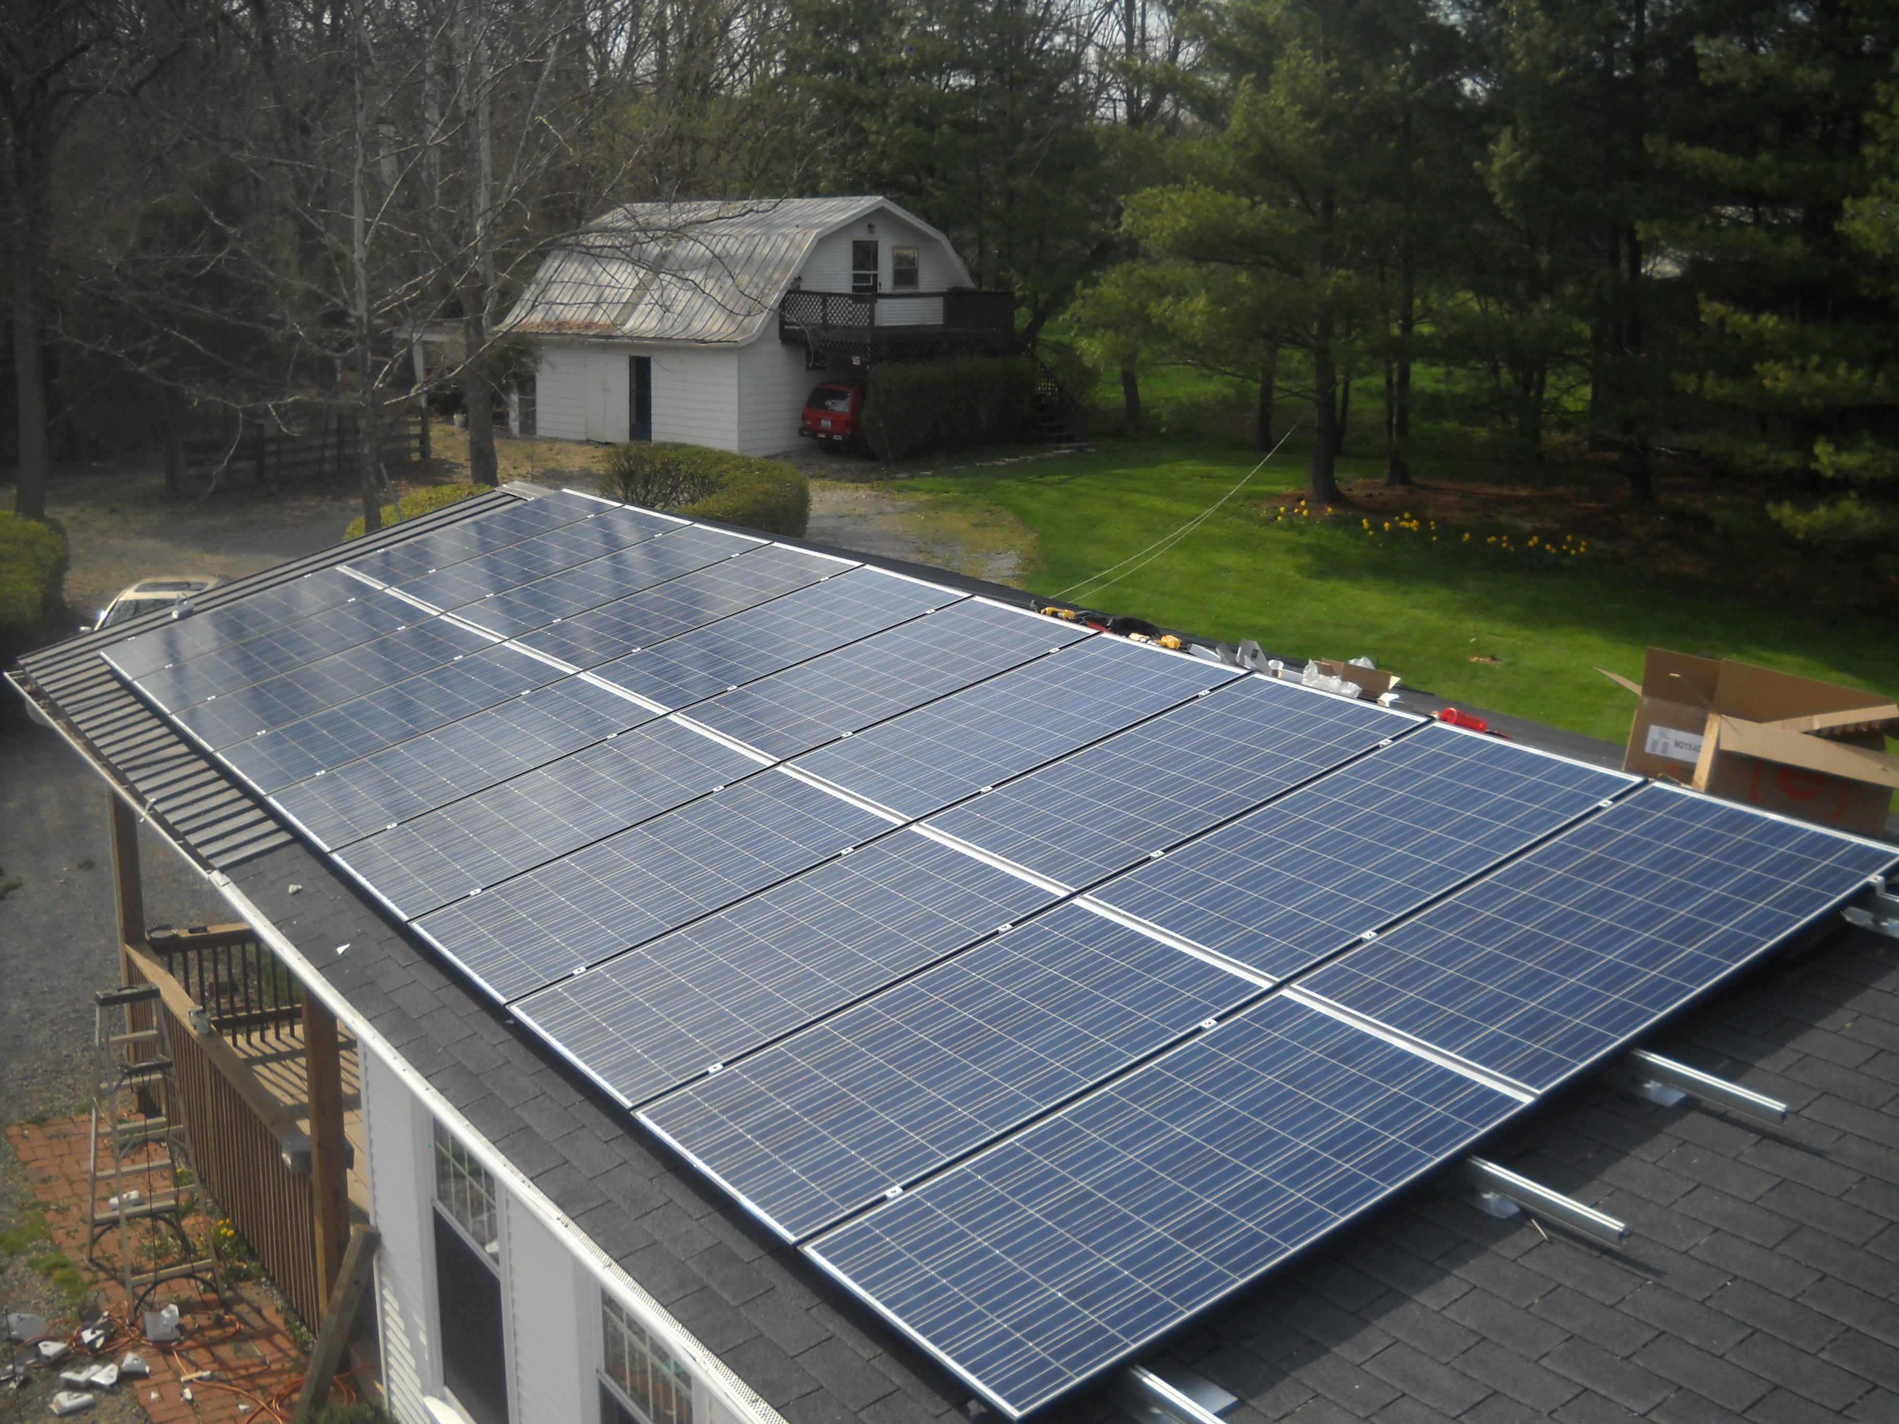

Slide 22
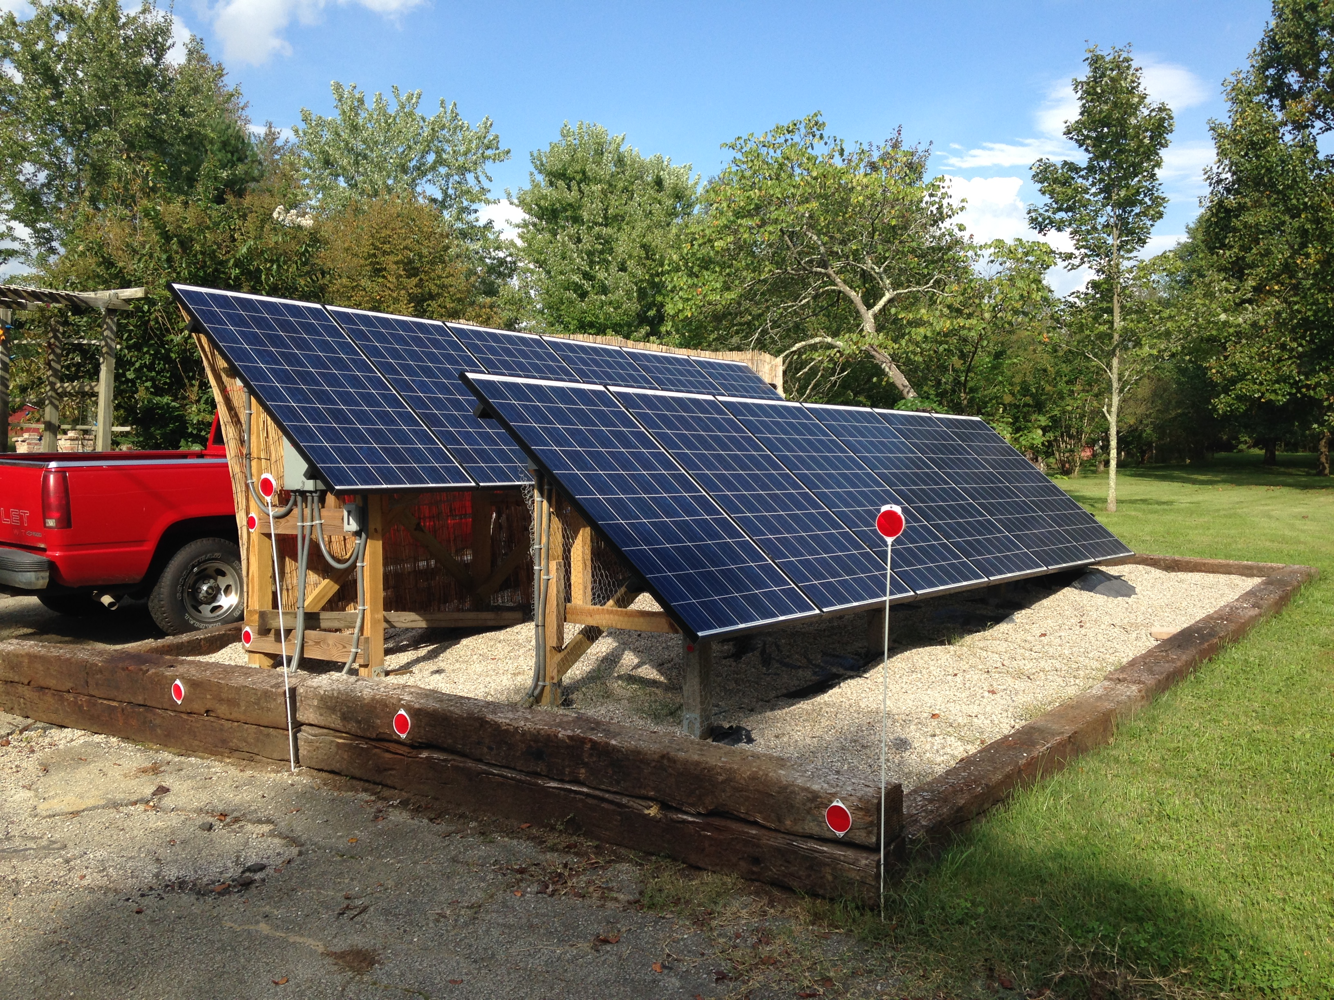
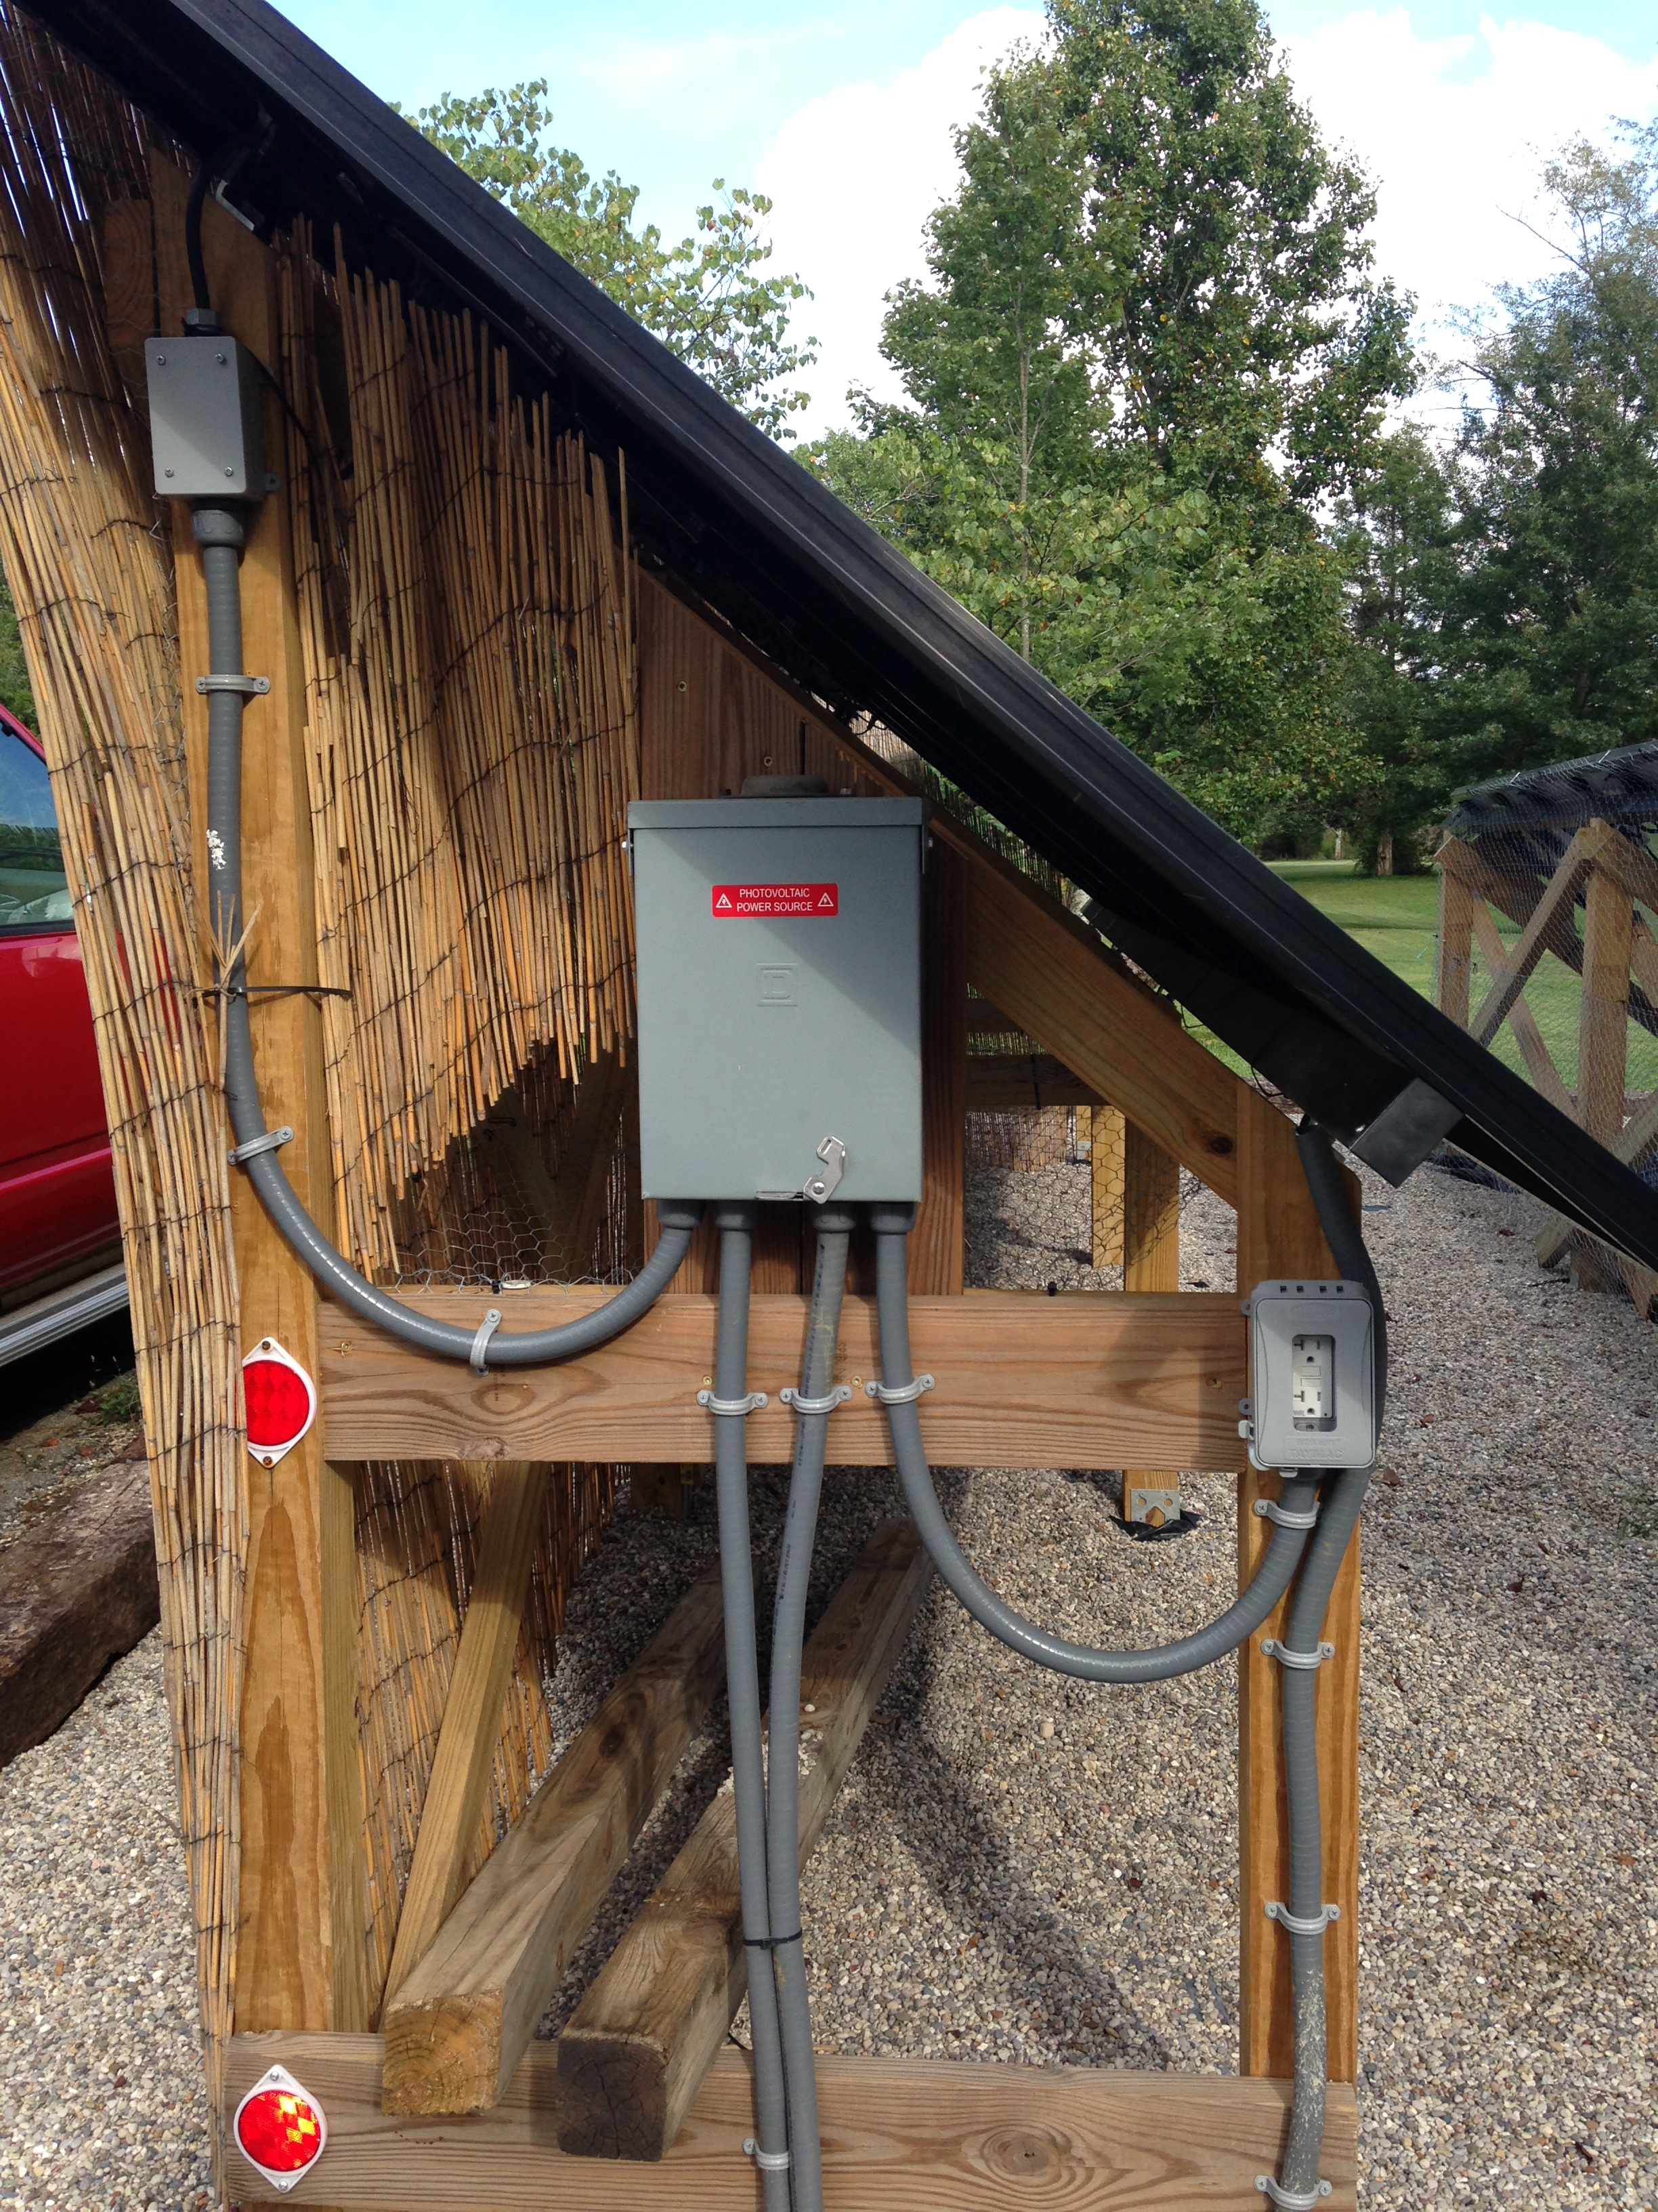

Slide 23
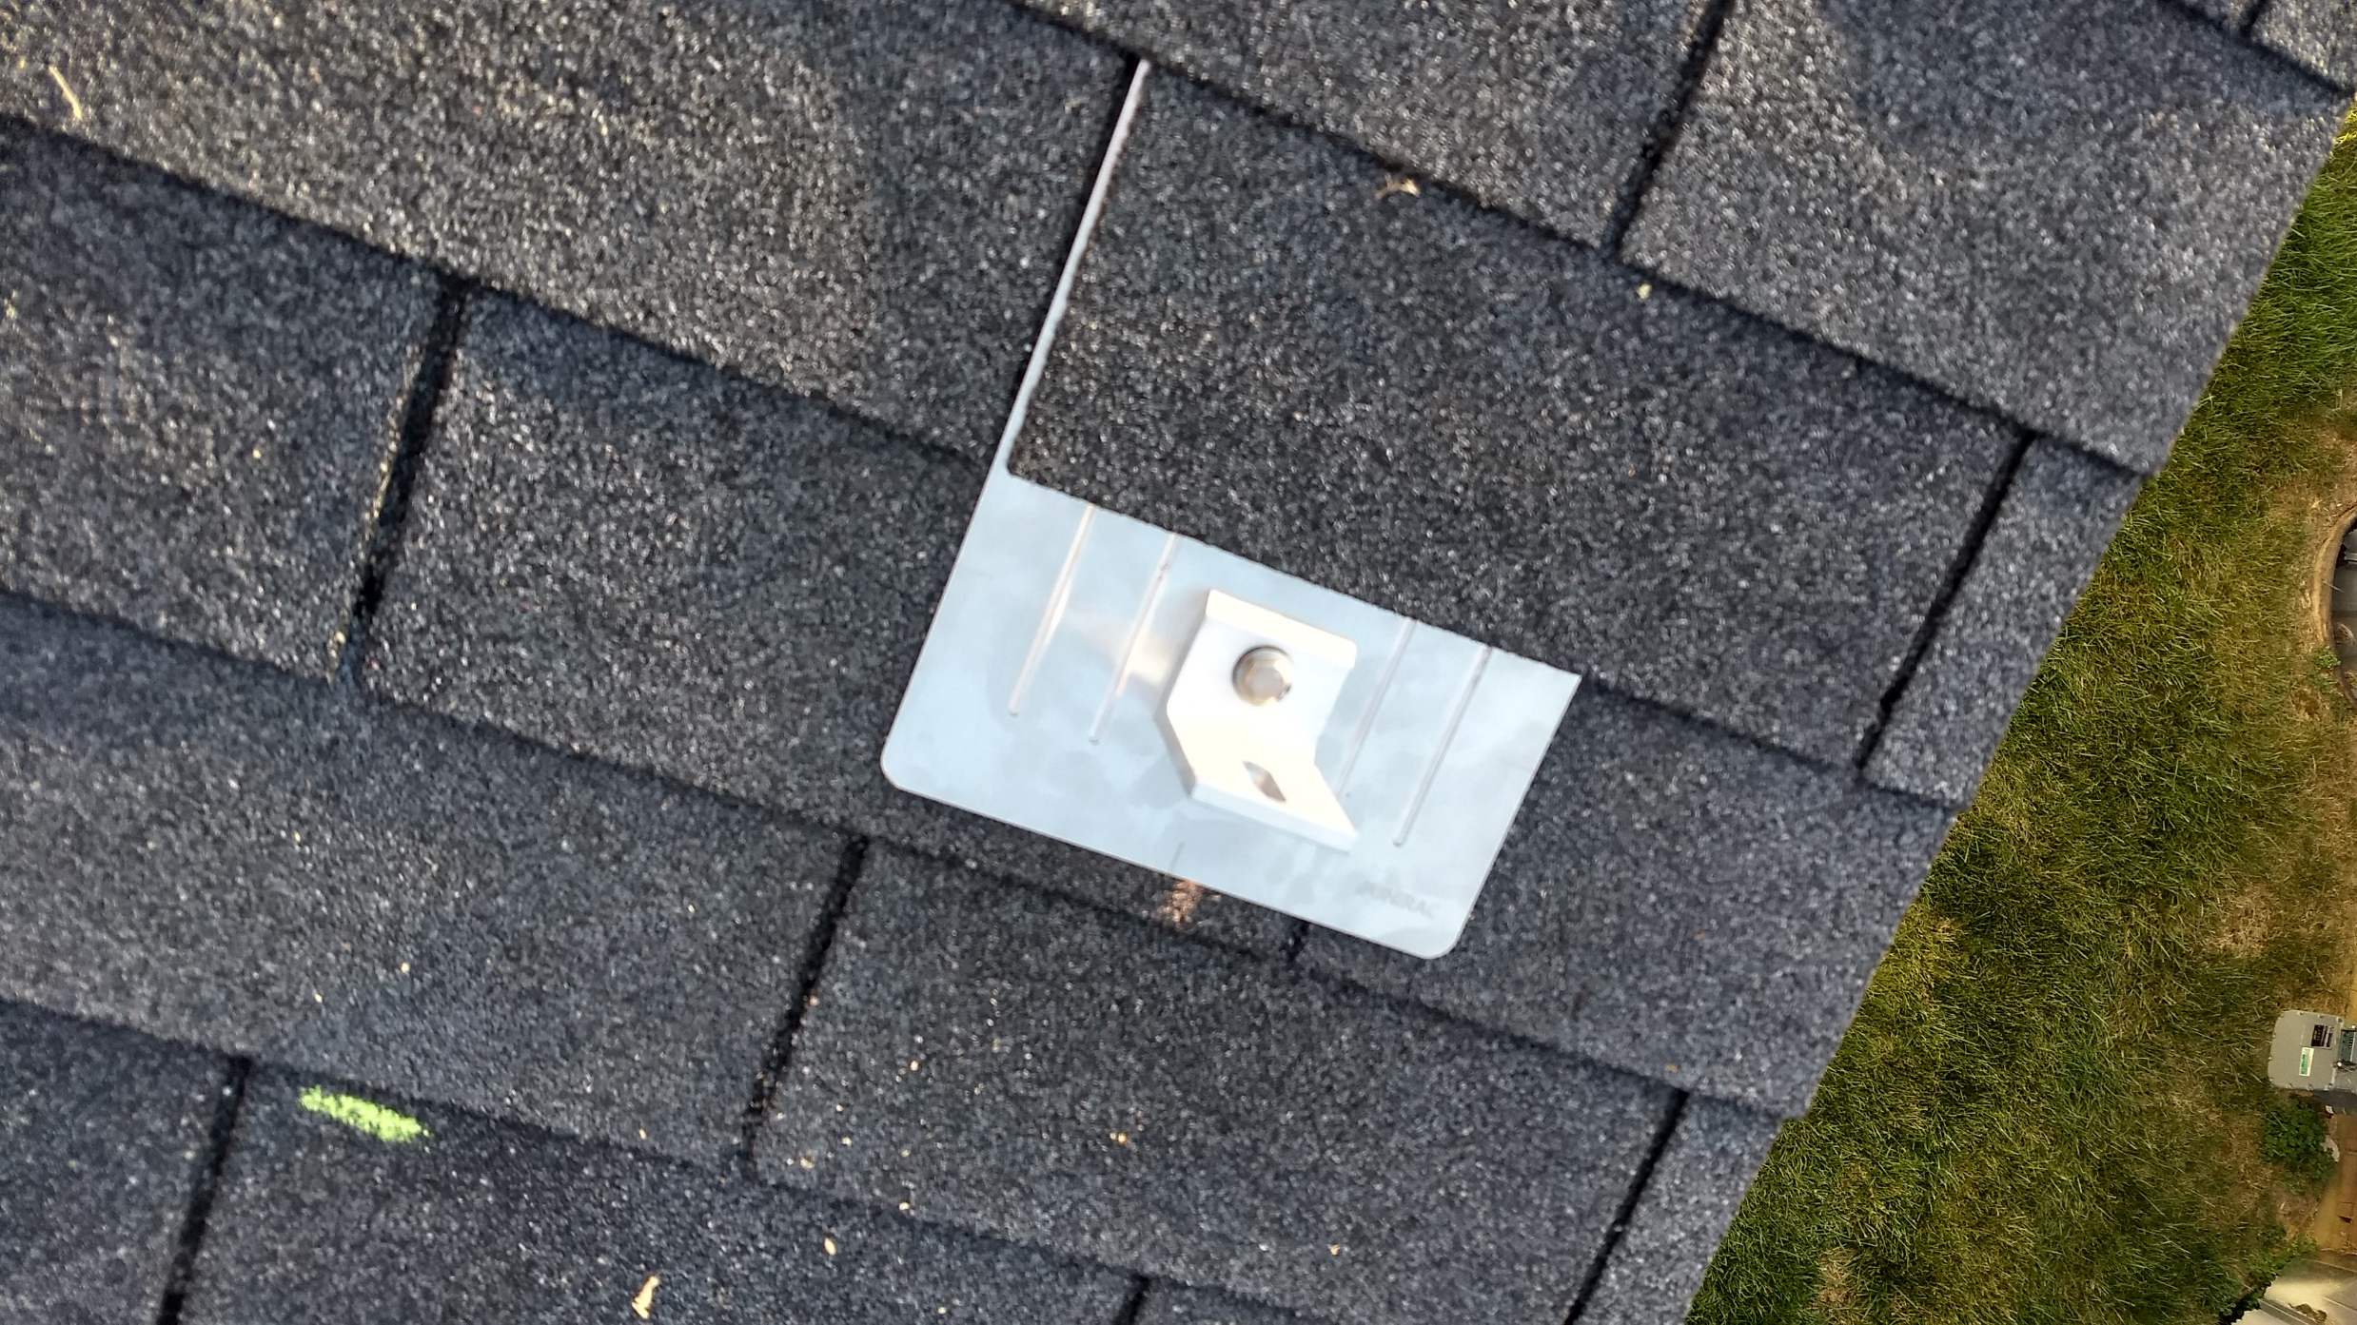
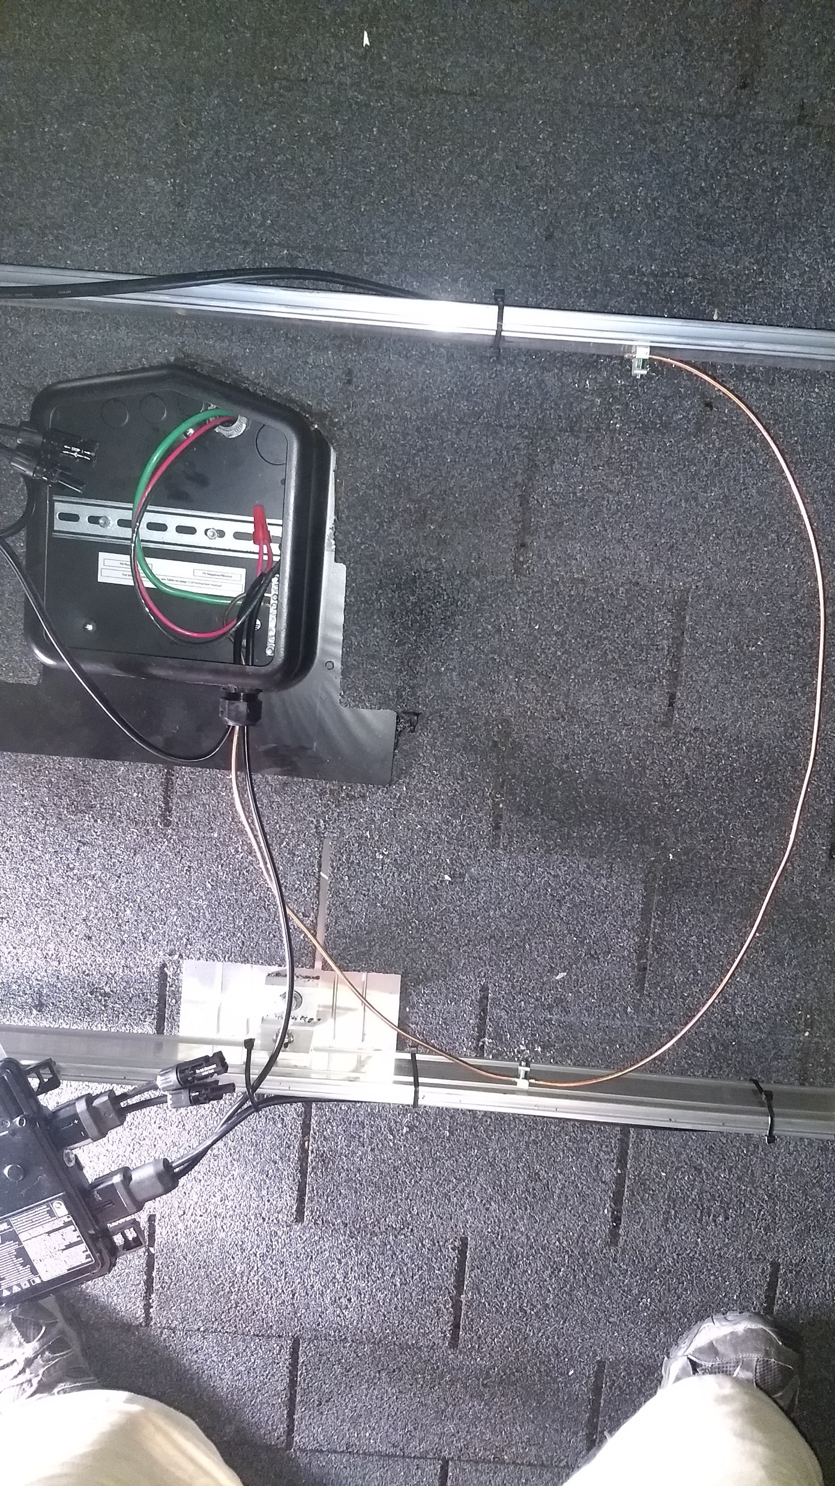
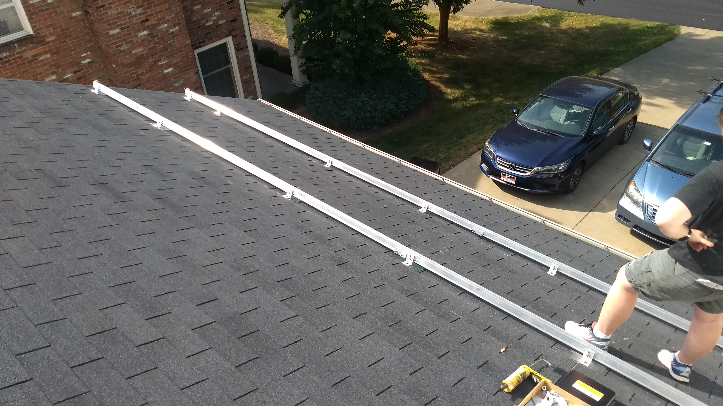

Slide 24
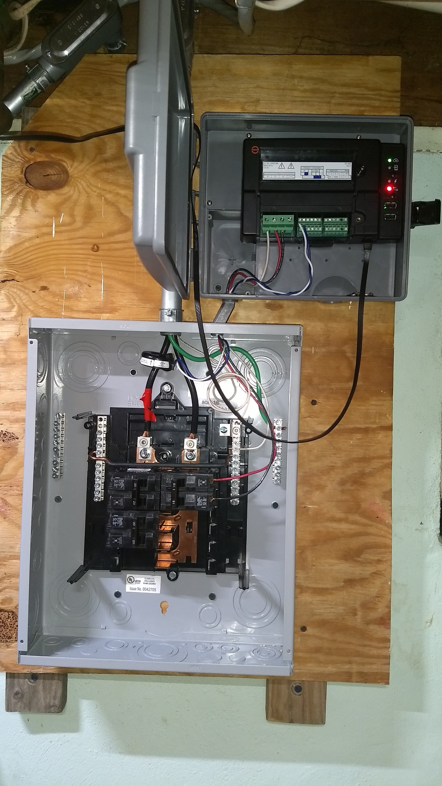
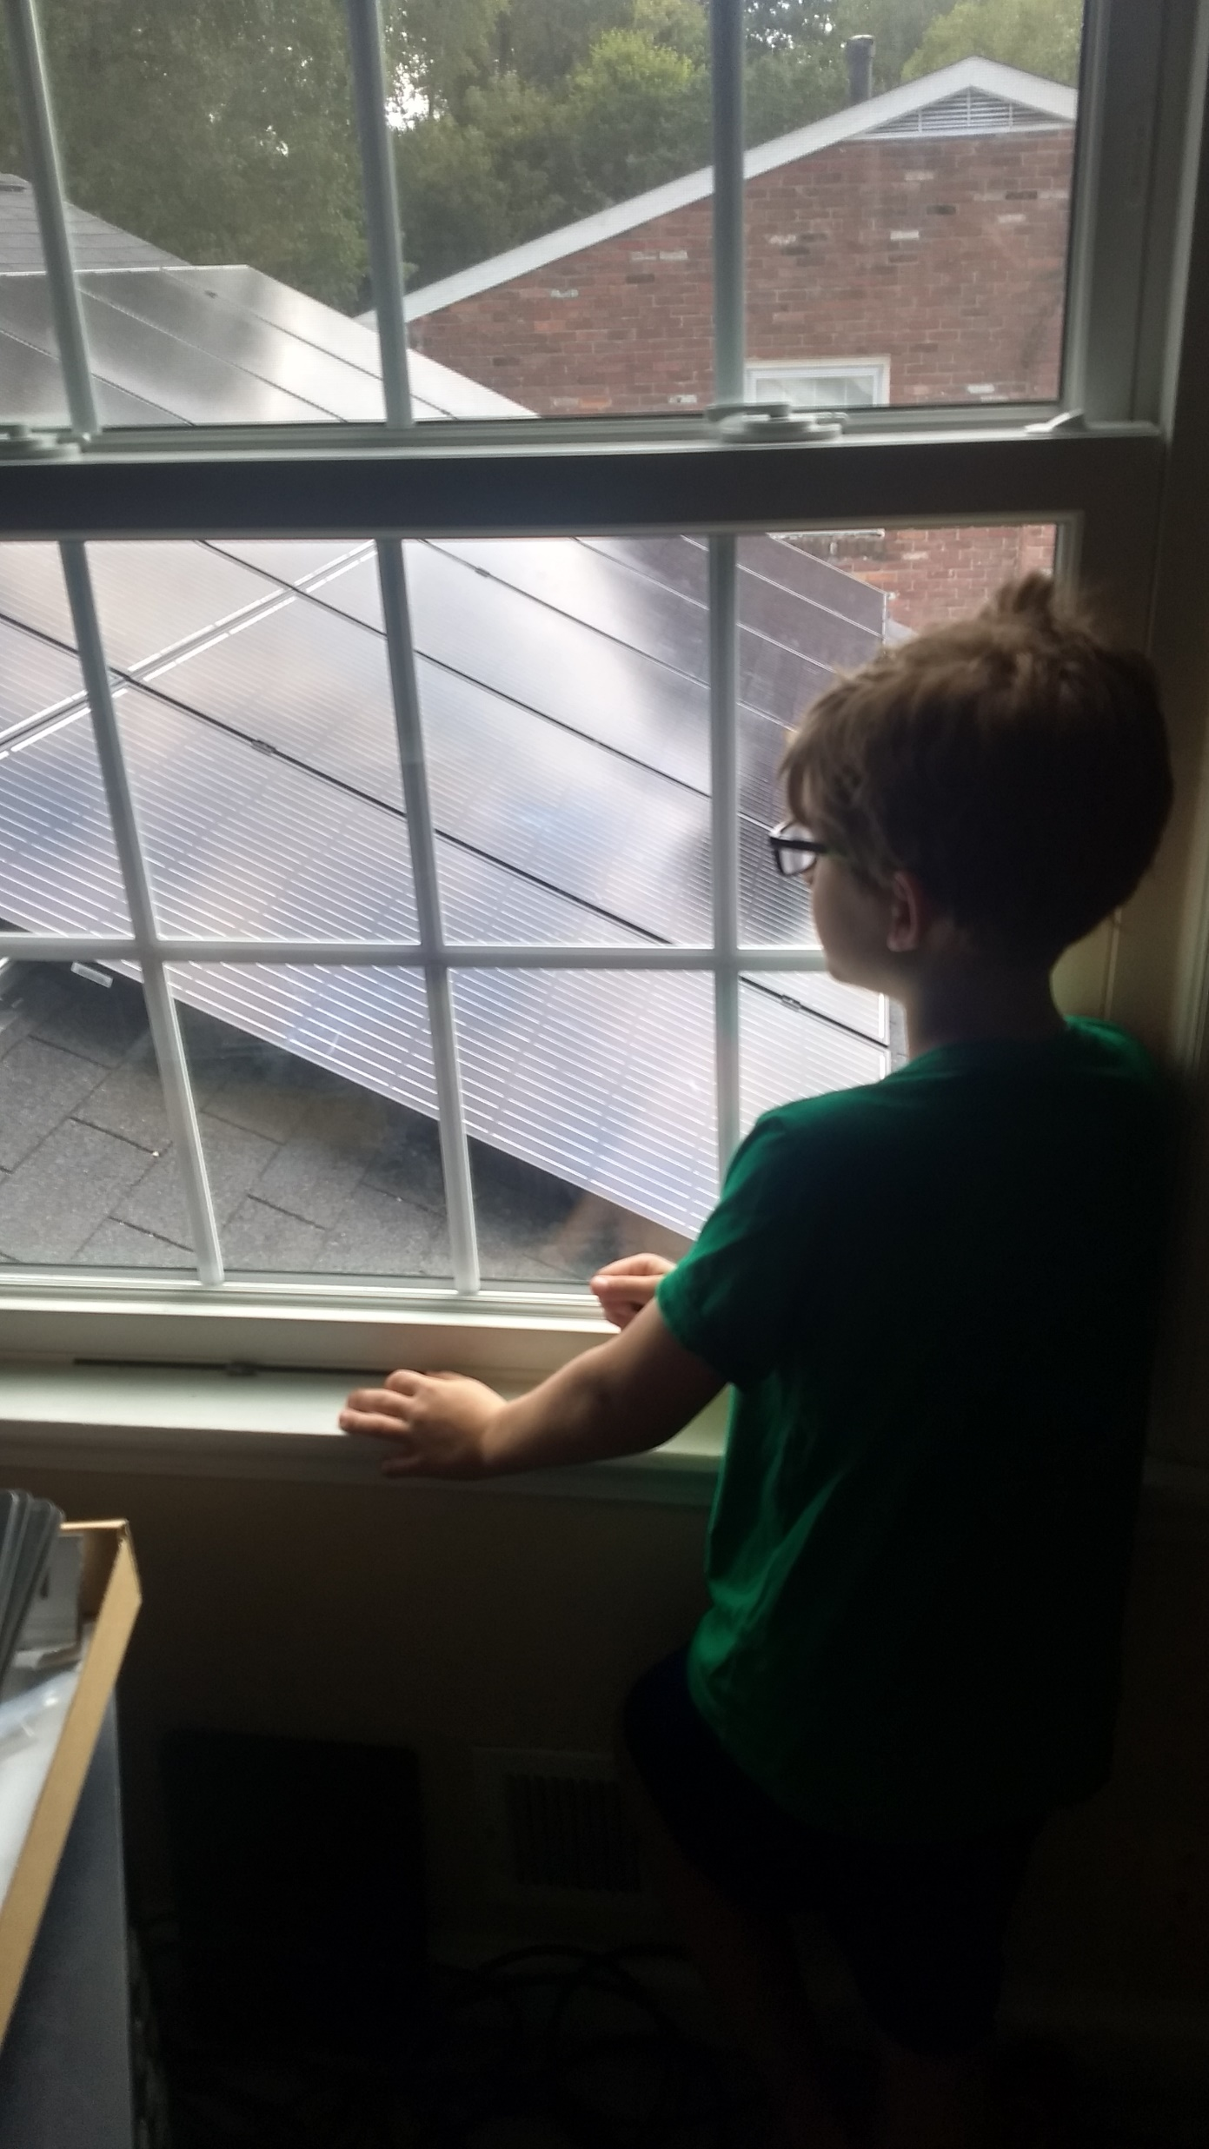
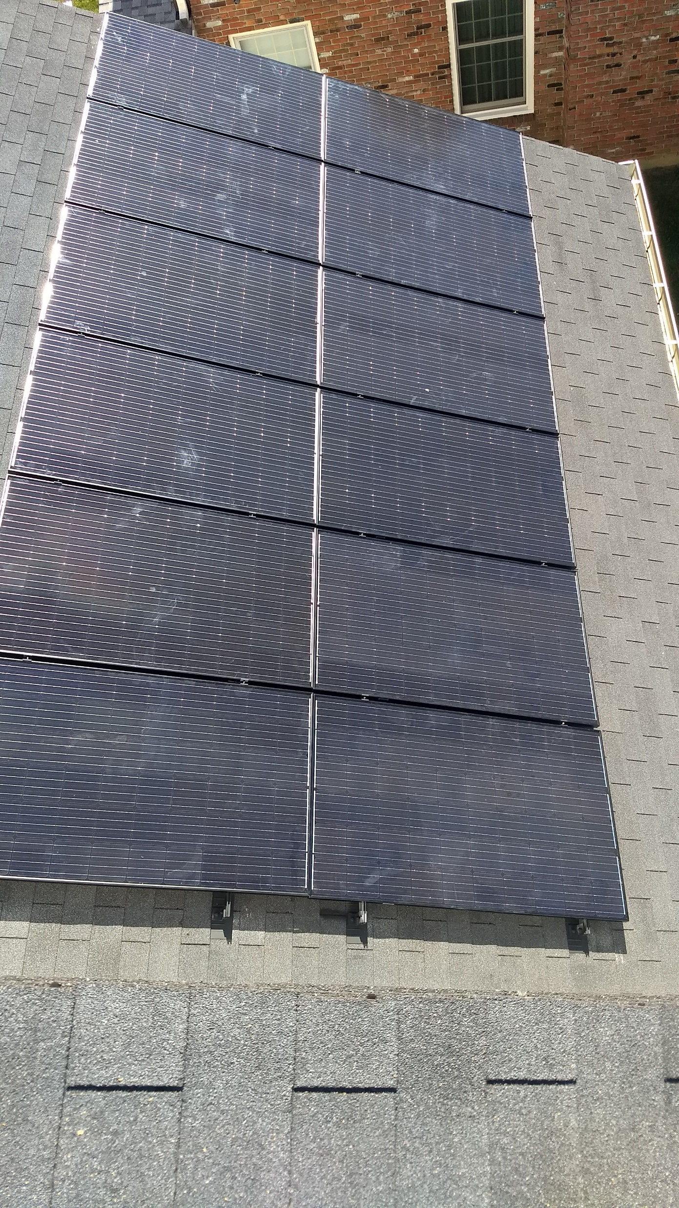

Slide 25
Suppliers
https://www.solarblvd.com/about-us/ low cost panels
https://www.anapode.com/content/Home complete system kits
https://www.wholesalesolar.com/ low cost parts
https://www.invertersupply.com/ low cost racking and inverters
http://www.dudadiesel.com/solar.php solar hot water systems
And of course https://www.ebay.com/
And my personal favorite: https://louisville.craigslist.org/

Slide 26
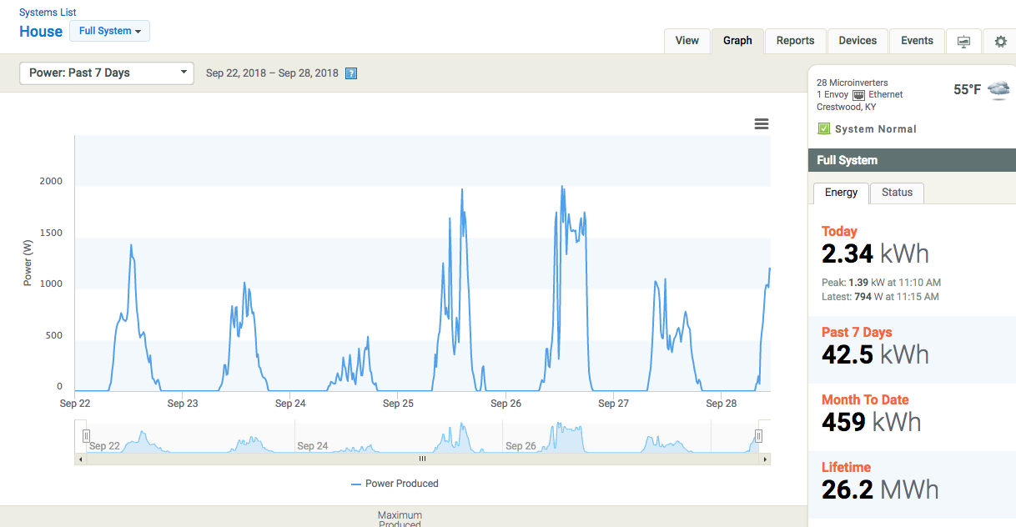
Toys – Enphase enlighten

Slide 27
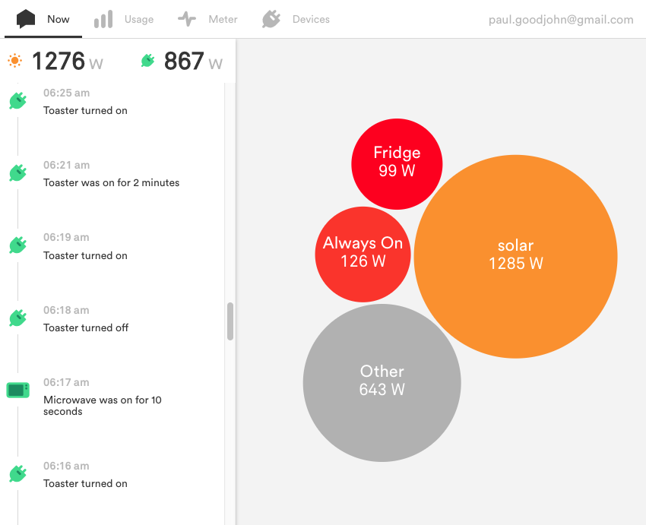
Toys - sense

Slide 28
State of Solar in Kentucky
Latest legislation puts more control in utilities hands
LG&E production is MUCH lower than anticipated based on growth models
2 coal “base load” plants offline (1 imploded a couple of months back) and 2 natural gas “peakers” offline due to demand reduction; This is being blamed on LED lights
No state refunds/ credits, etc. for solar
Reasons to do it: 26% (to end of ‘20) and 22% (to the end of ‘21)
Net metering (buy/sell 1:1) until 1% of utility’s peak demand is met by solar ****LG&E is buying land in all counties served to build arrays which will count toward the 1% (Will sell you power at an increased rate to help finance their solar array)

Slide 29
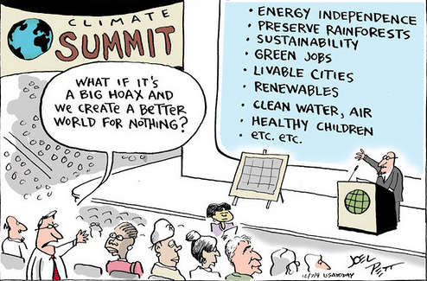
Questions?

